Slide 1
Estimating Precipitation Particle
Number Concentration per Cubic Meter Using
Computer Vision
By davy3d

Slide 2
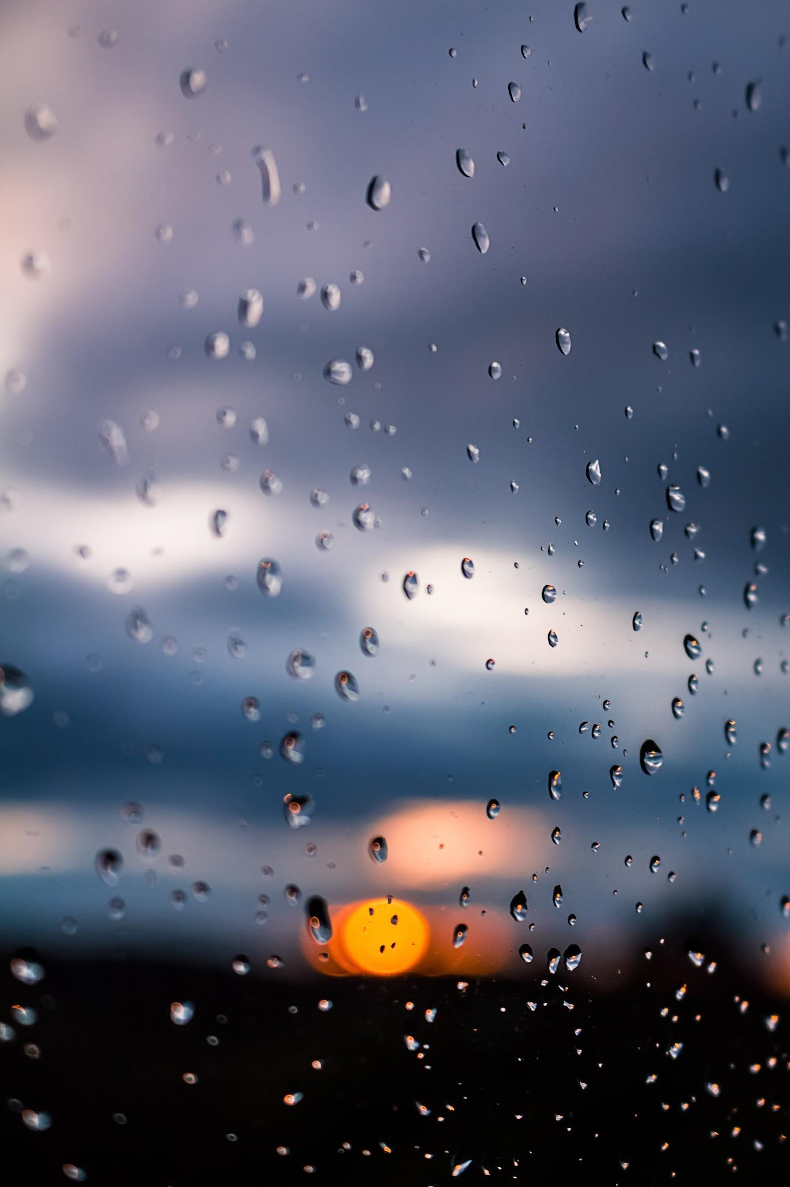
Justification
My justification for this project is that I am interested in computer vision and I like to code. I wanted to know how hard it rains outside in real time.

Slide 3
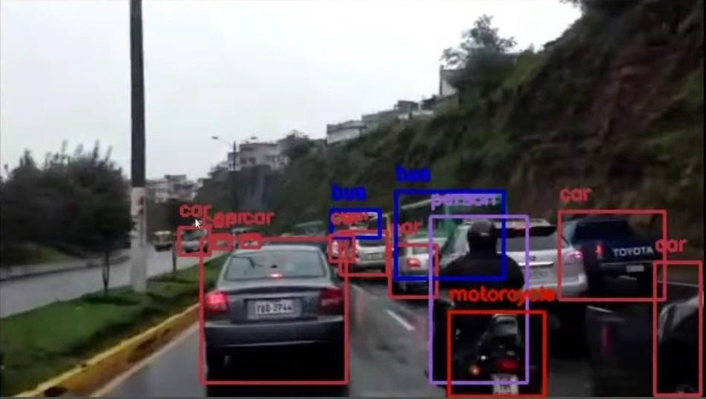
Vocabulary
Computer Vision: Computer vision involves how machines understand and interpret the visual world.
YOLO: YOLO stands for You Only Look Once, which is a one-stage computer vision object detection method.

Slide 4

Vocabulary
Python: Python programming language is a high-level, general-use programming language.
CSV: CSV stands for Comma Separated Values, and is a simple way of storing information that is easy to use and manipulate.

Slide 5

Research - Artificial Intelligence
Artificial intelligence describes computer systems that can perform complex tasks normally done by humans.
Machine learning is a computer learning without human input.

Slide 6

Research - OpenCV
OpenCV is a popular computer vision library.
An OpenCV motion detection method is to find a common background image, then subtract it from an image from the same feed. Any parts of the picture left over are detected as motion.

Slide 7
Research - Object Detection
Different methods for object detection are Haar Cascades, Histogram of Oriented Gradients (HOG), Scale-Invariant Feature Transform (SIFT), You Only Look Once (YOLO), and Single Shot MultiBox Detector (SSD).
The YOLO object detection method is a convolutional neural network that is able to detect, classify, track, and estimate the pose of an object.

Slide 8
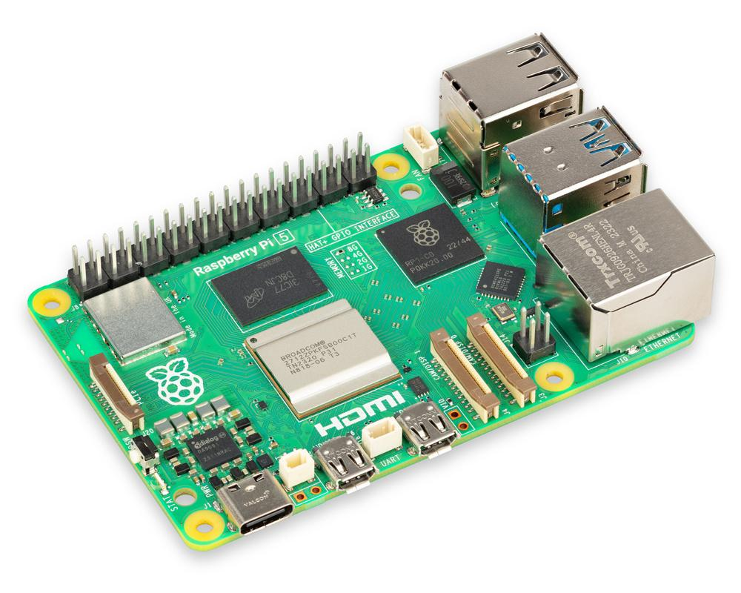
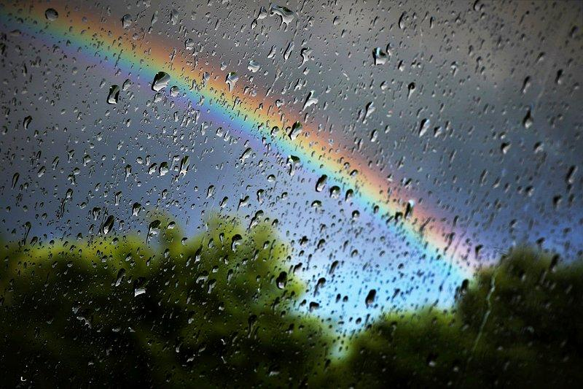
Research
The Raspberry Pi is small, lightweight computer.
In rain, raindrop concentration usually ranges from
100 to 1,000 drops per cubic meter.

Slide 9
Objective
The objective of this project is to use a Raspberry Pi and Python to detect rain or snow, namely precipitation, and detect the density of the raindrops, or particles, using computer vision.

Slide 10
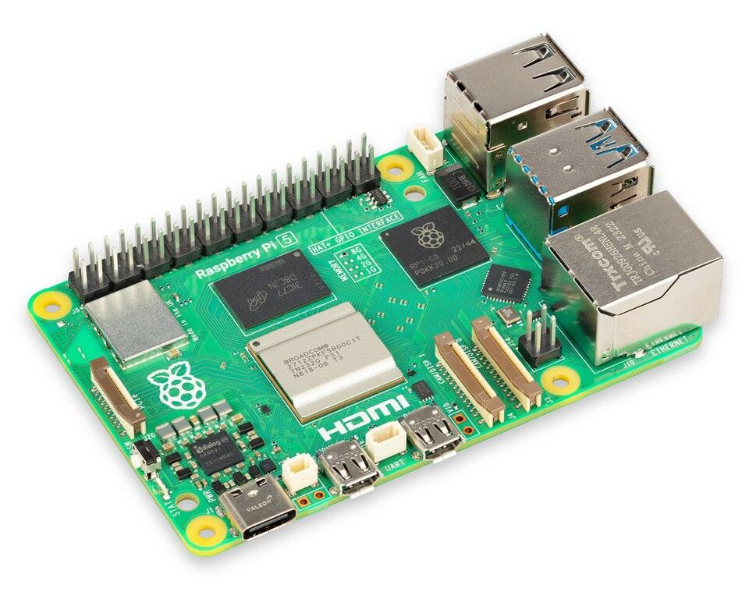

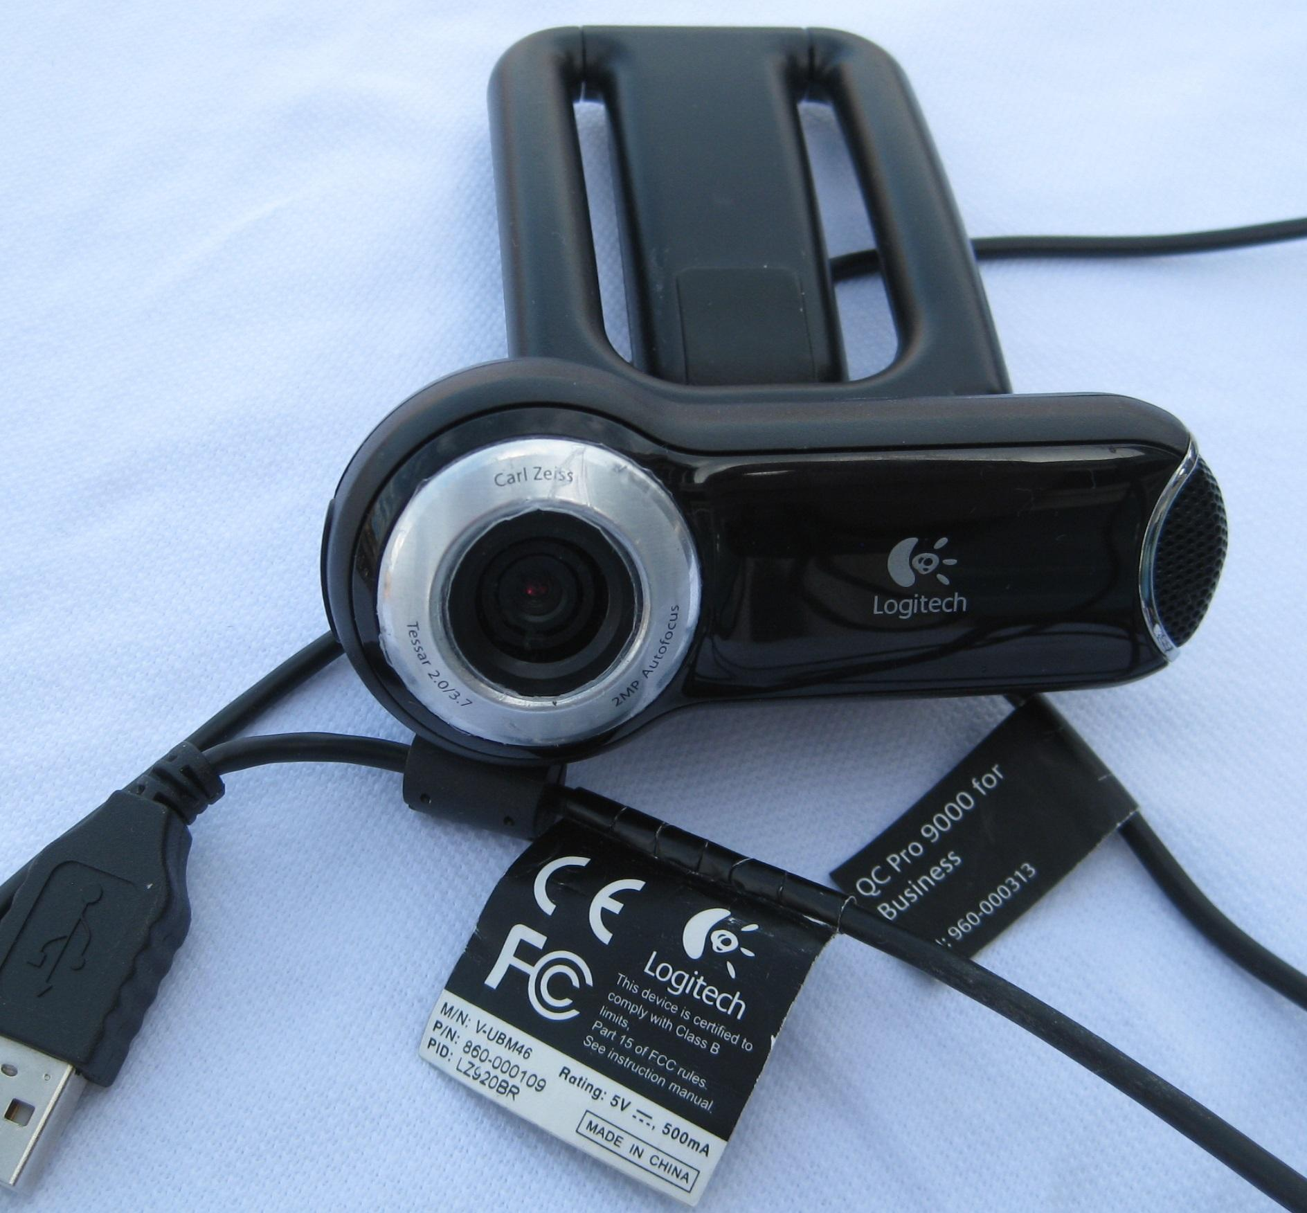
Materials
2 USB web cameras
1 Raspberry Pi computer
1 Flat platform
1 Surrounding rig (including materials)
Python programming language
1 3 meter USB cable
1 Laptop
1 USB hub
2 Garden floodlights

Slide 11
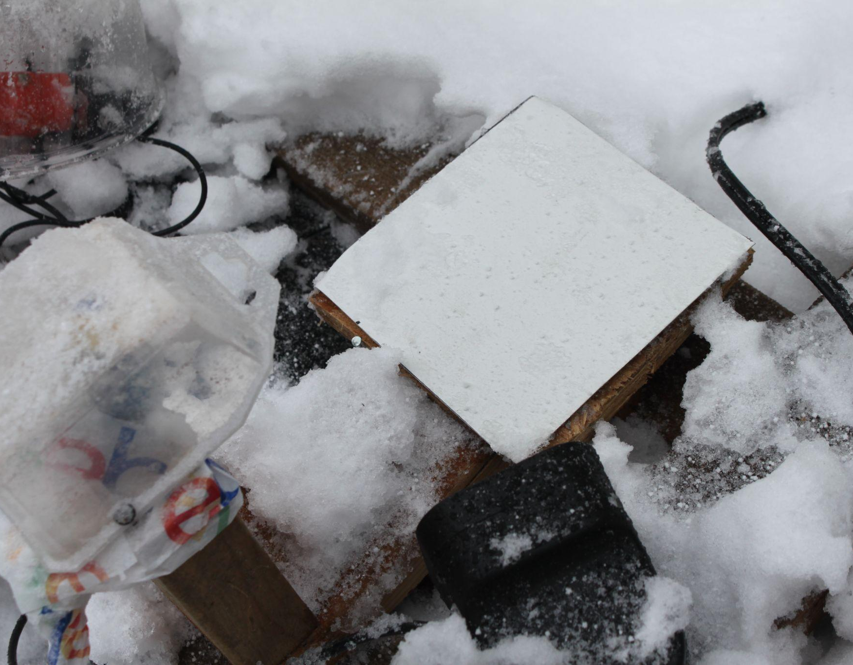
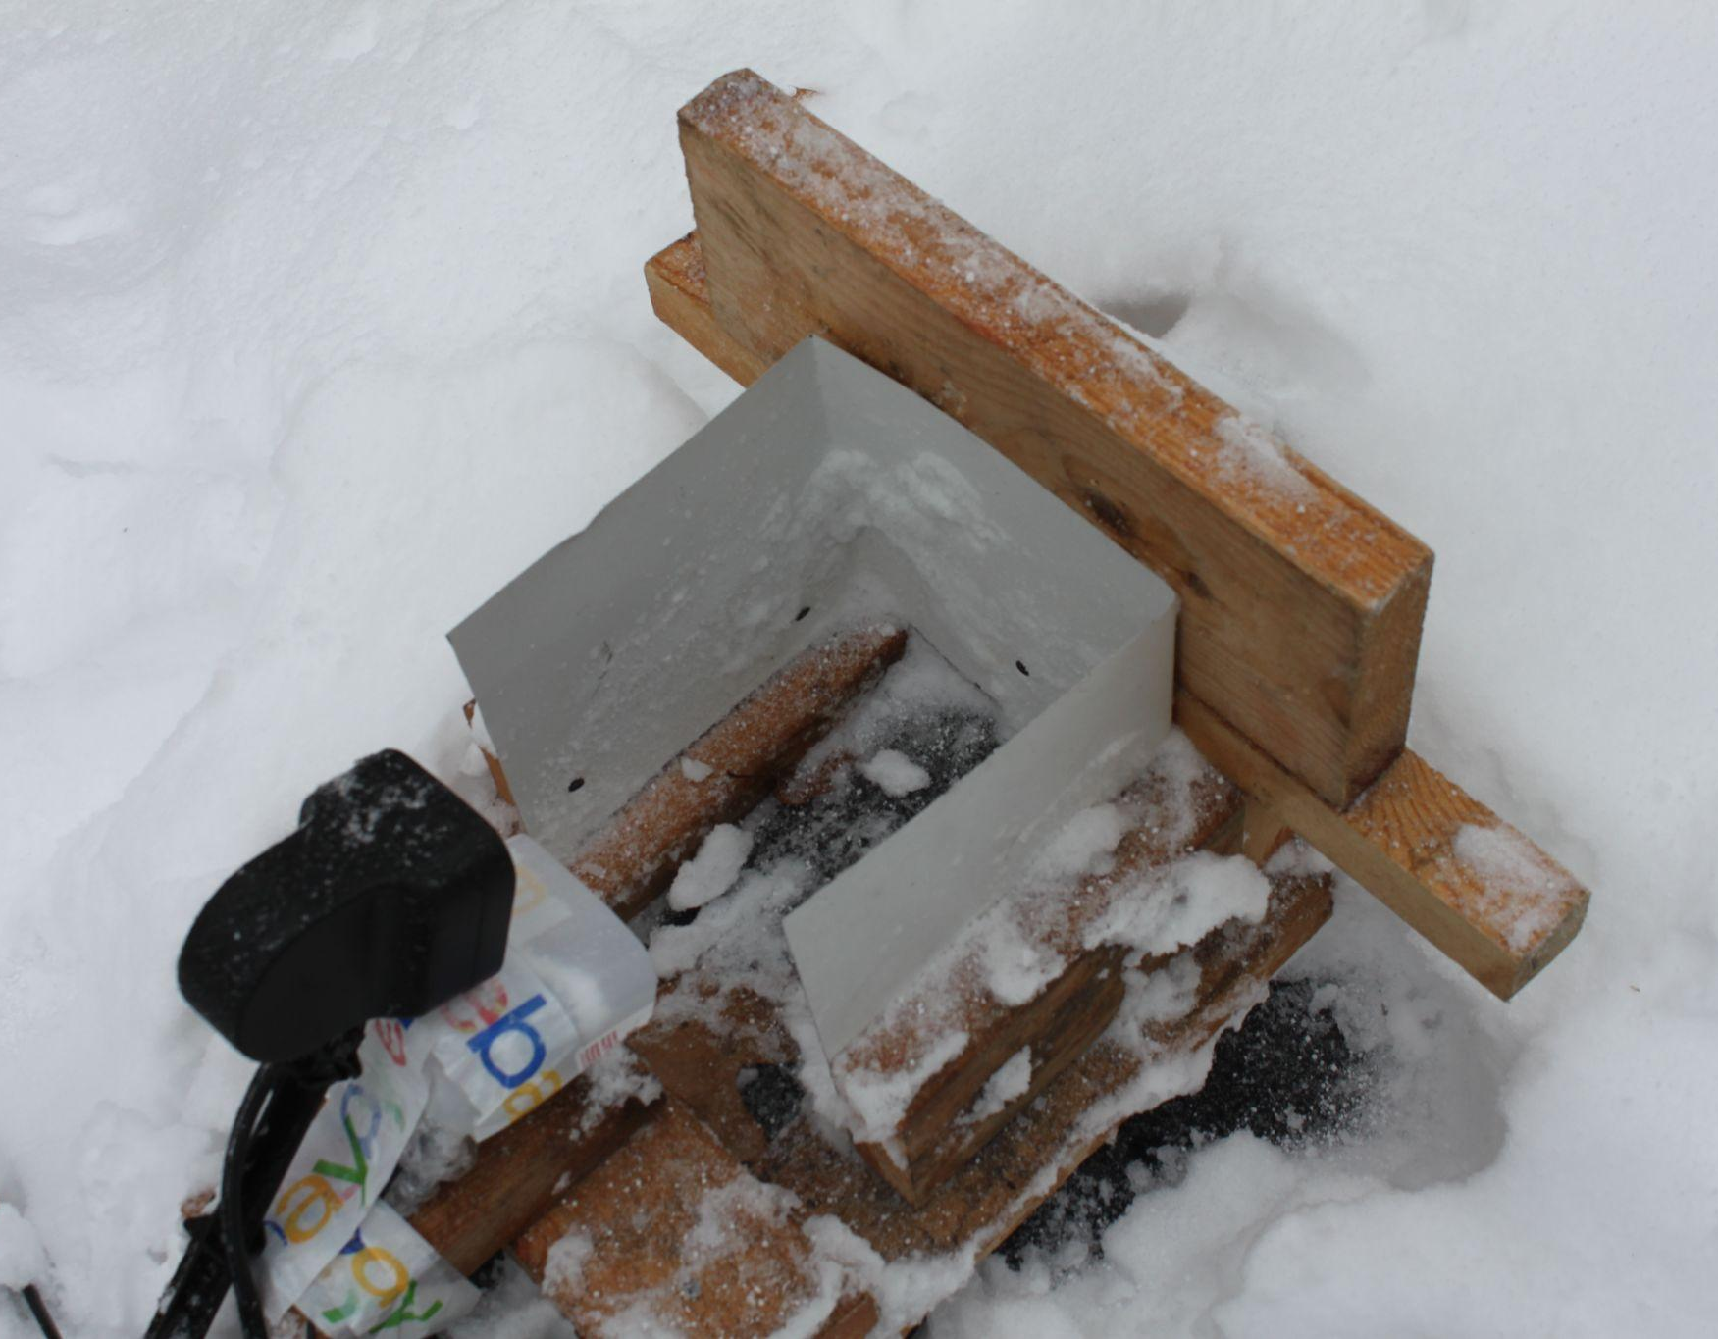
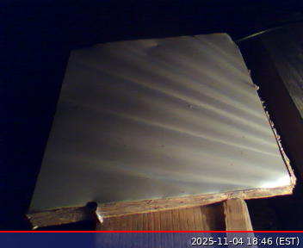
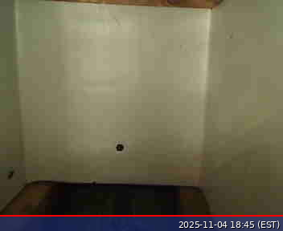
My Platforms and Rigs
This is my flat platform.
This is my surrounding rig.

Slide 12
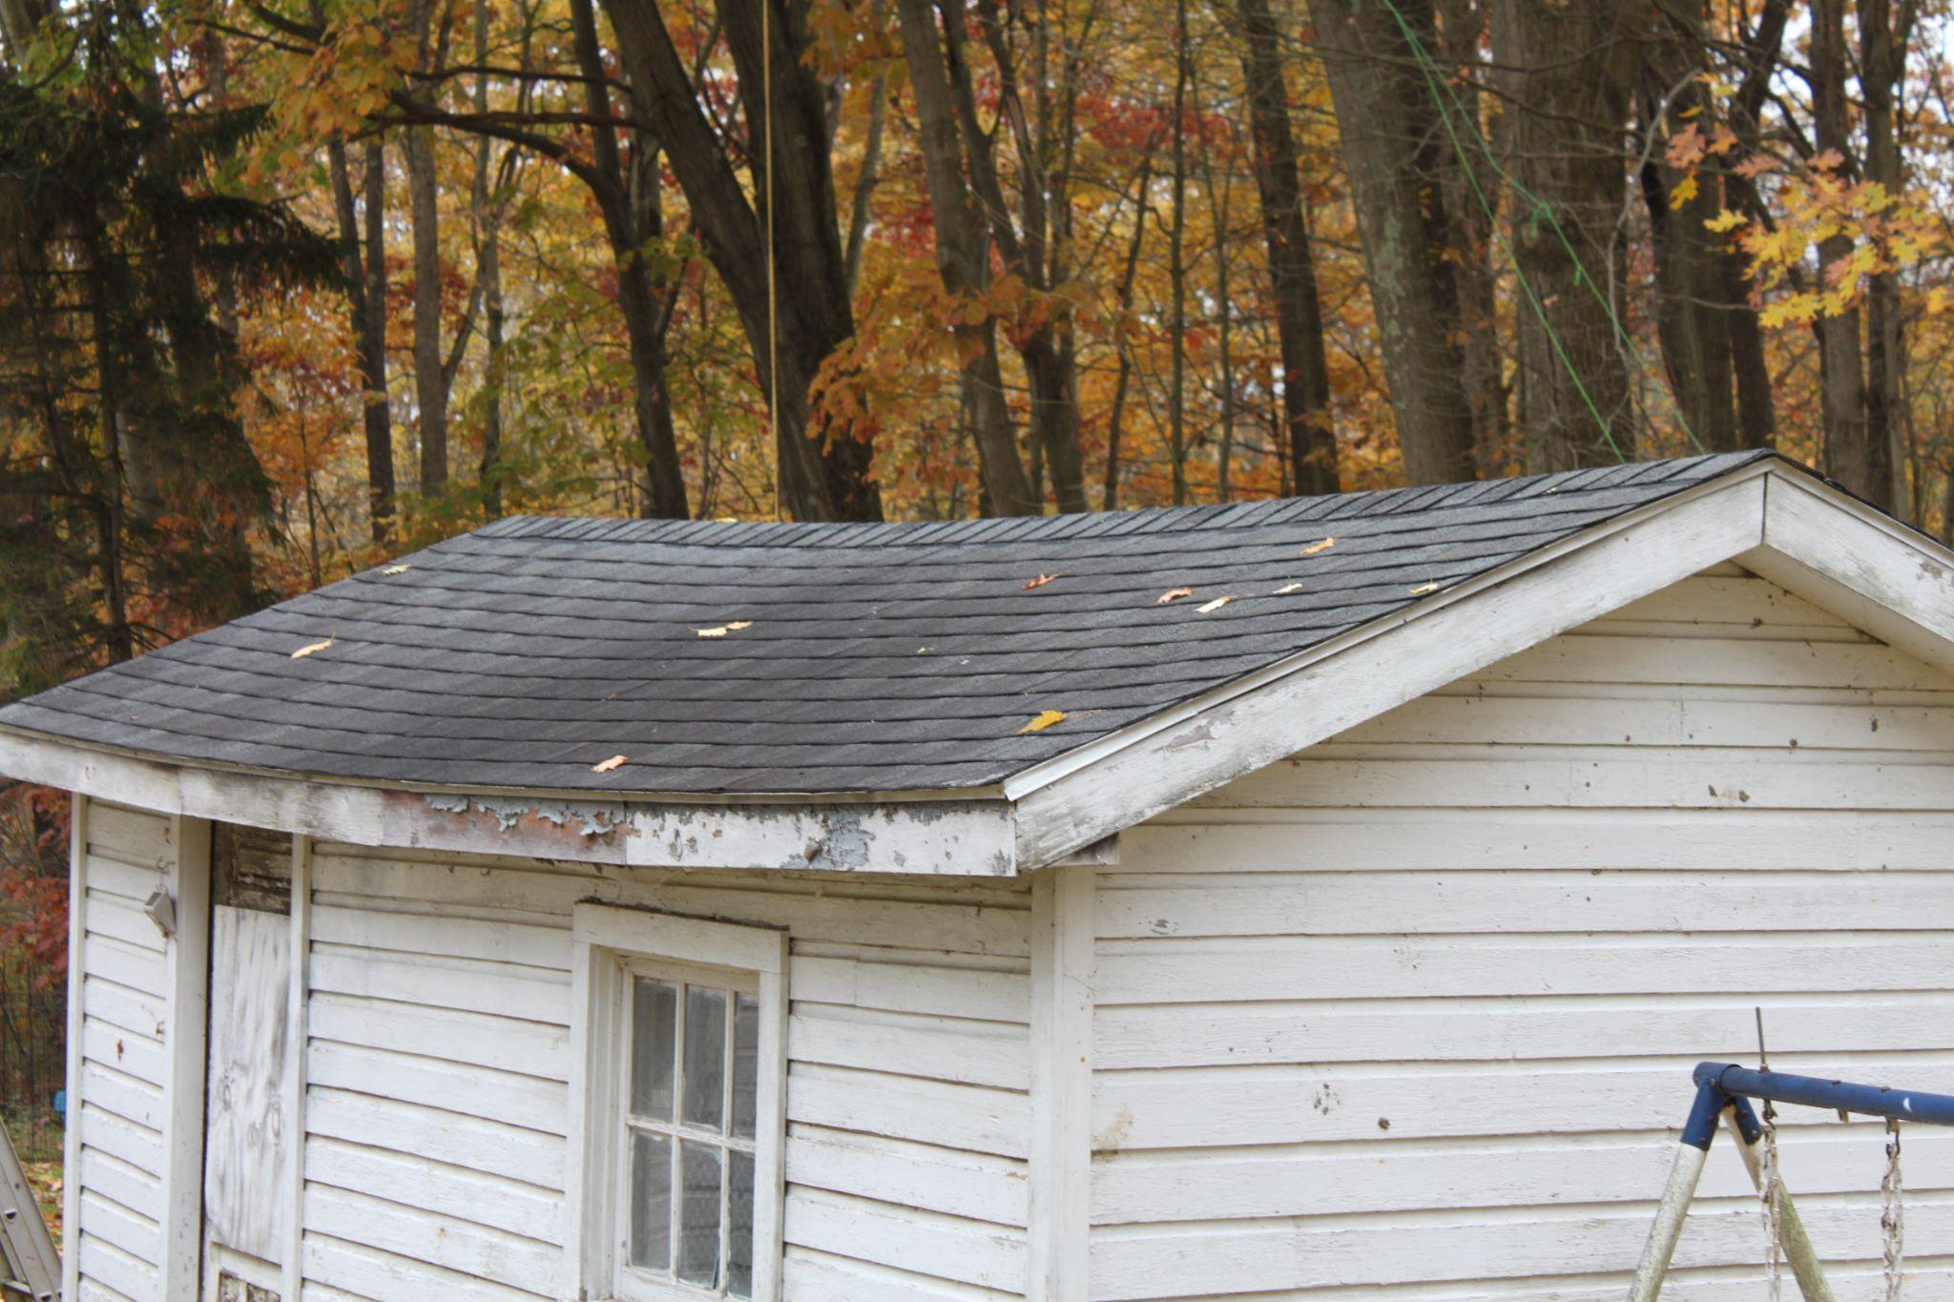
Procedure
1. I collected the materials.
2. I built the rigs.
3. I put the rigs on the peak of a shed roof.
4. I set up the Raspberry Pi and connected it to the cameras and the network.
5. I wrote a Python script to take pictures to train my object detection model and ran it.
#3

Slide 13
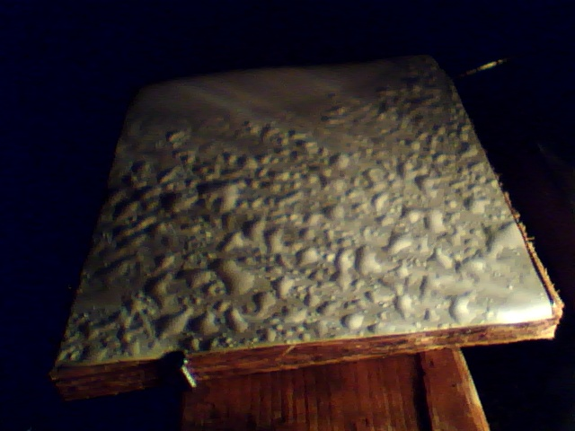
Procedure
#7
6. I wrote my Python program to use the cameras to detect
motion with one camera and precipitation with the other. The motion detection detected motion and counted any areas of motion as a raindrop.
7. I trained my YOLO object detection model with pictures of precipitation that I took with my program on my flat platform.
8. I ran my program all day and night for eleven days and wrote the output to a CSV file.

Slide 14
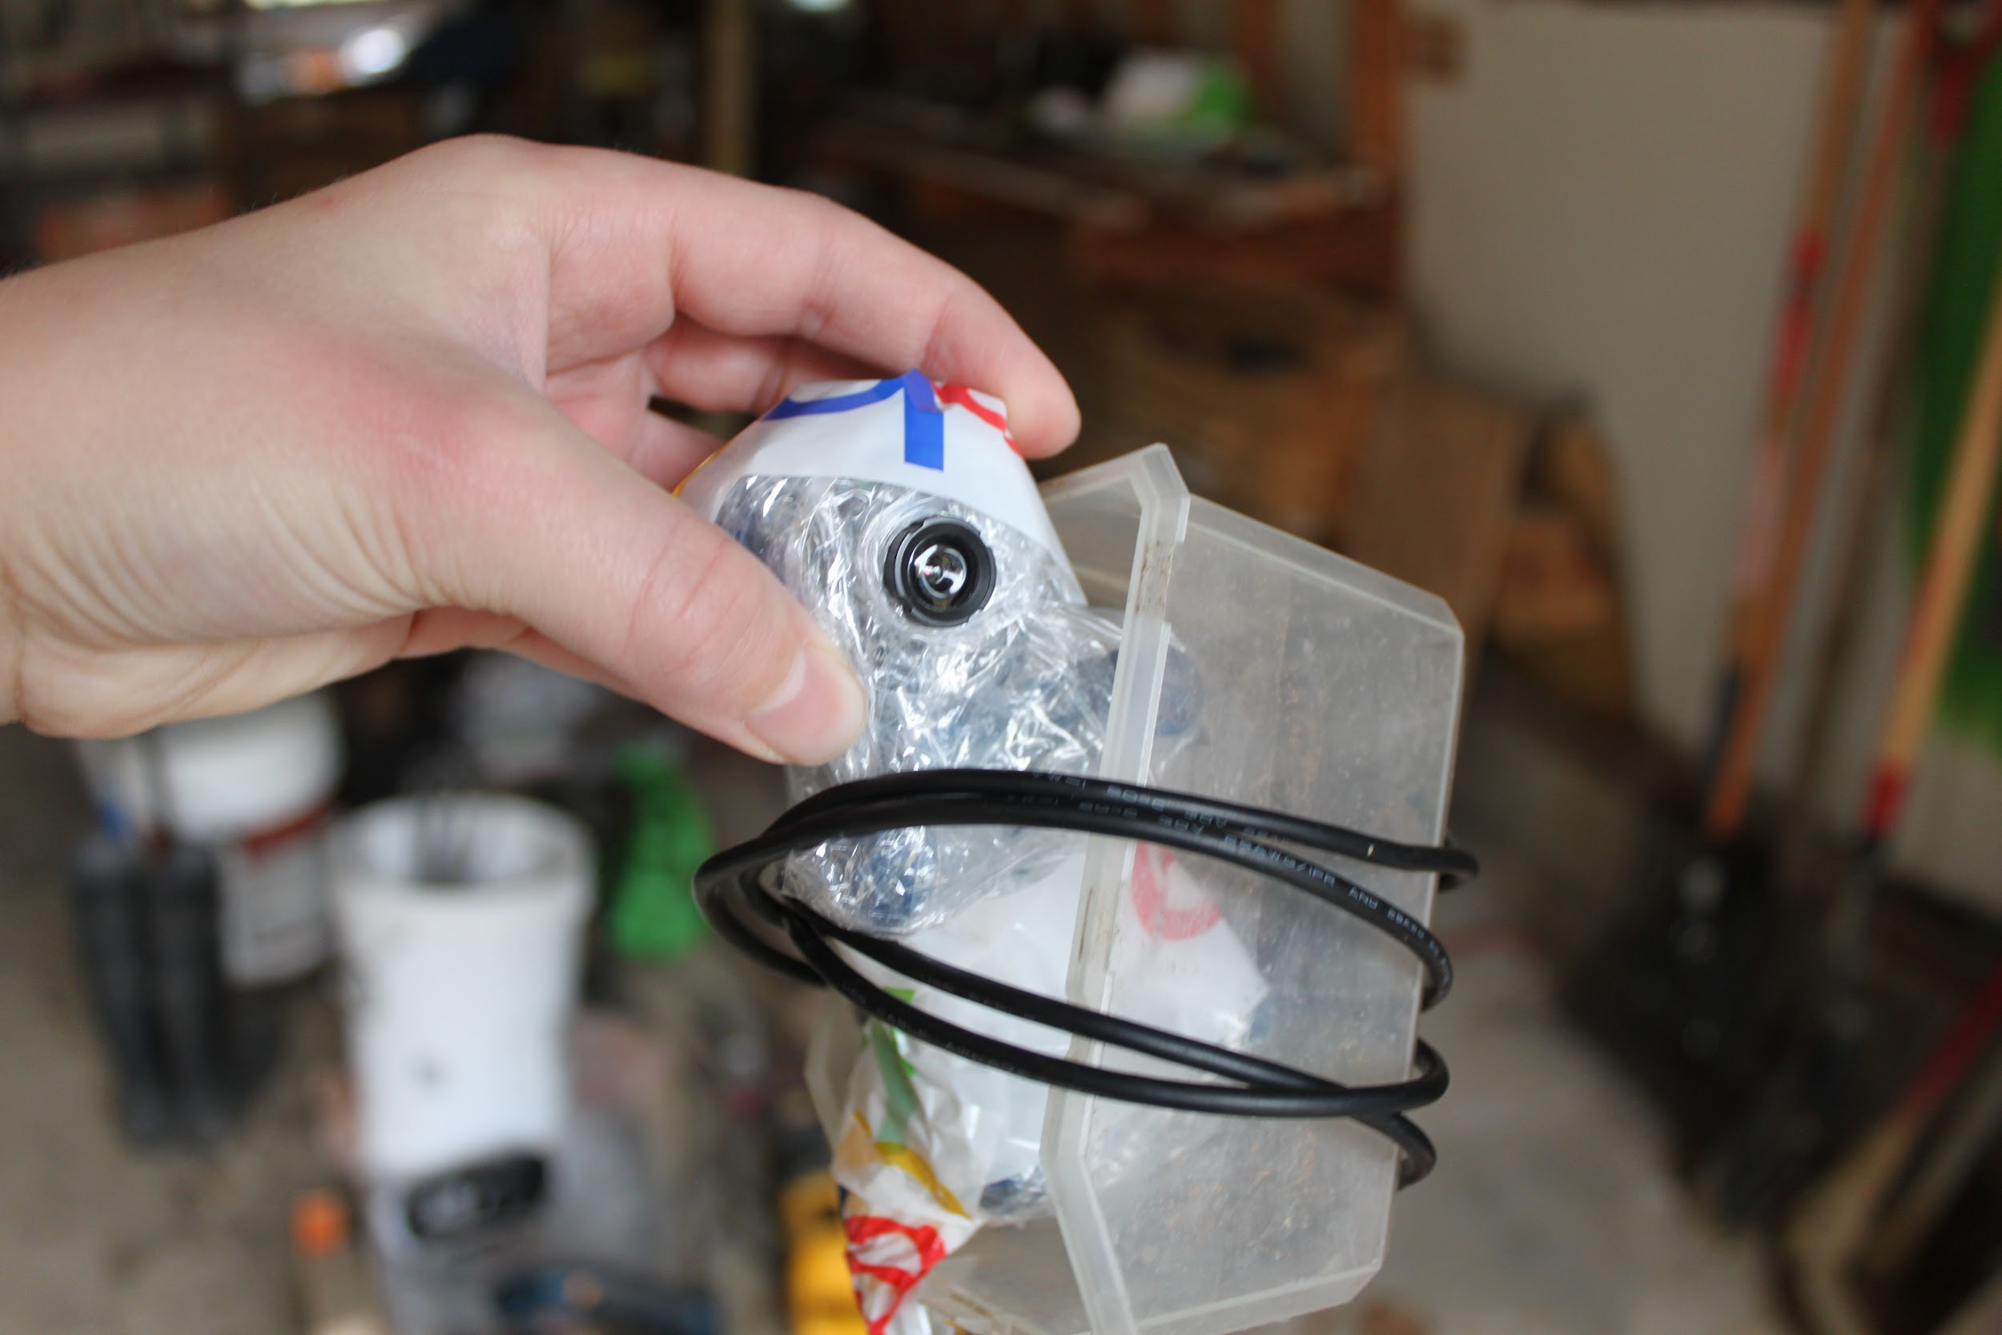
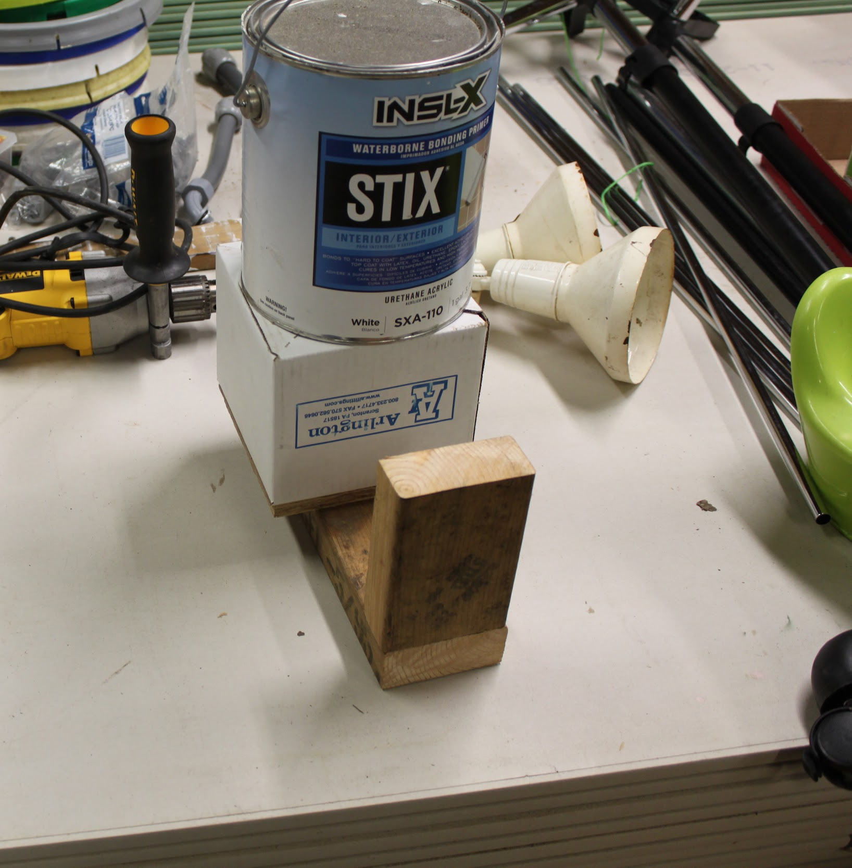
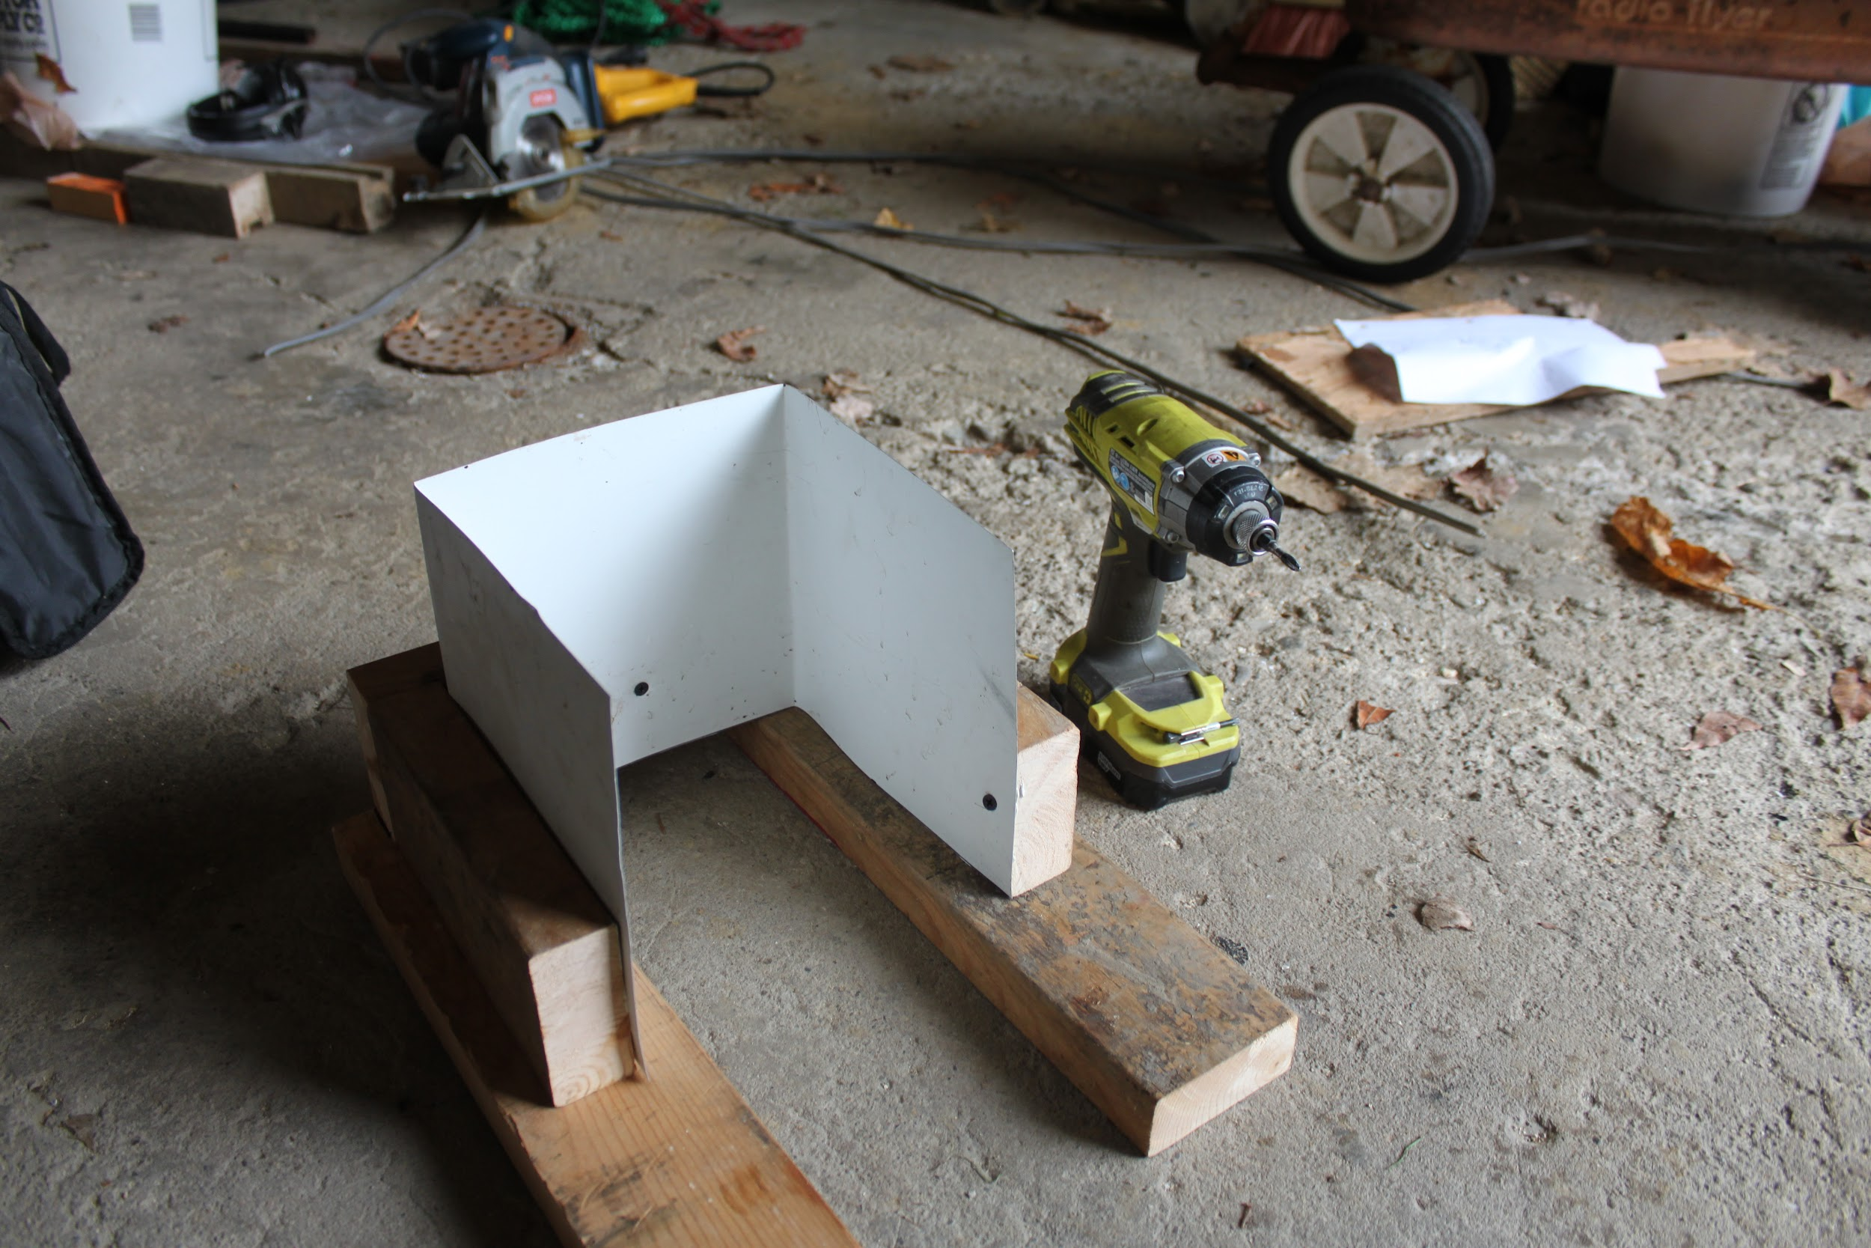
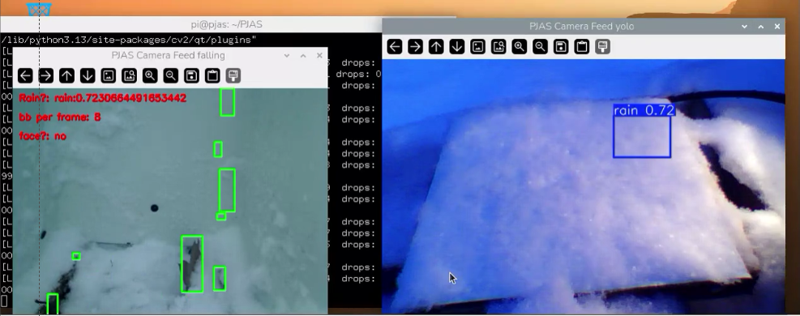
Pictures
#2
#1
#4
#3

Slide 15
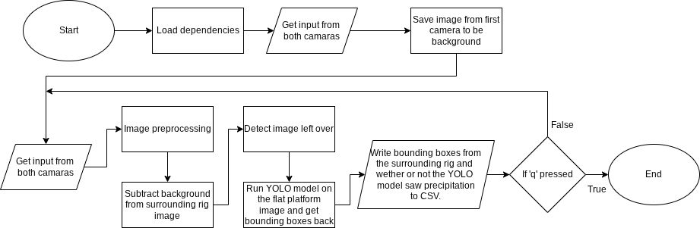
Flowchart

Slide 16
YOLO Object Detection Logic
1 results = rainmodel.predict(source=frameyolo, stream=True, conf=0.7, verbose=False)
2 confidence = ''
3 class_name = ''
4 class_name_conf = ''
5 for result in results:
6 # The 'plot()' method automatically draws
7 # the bounding boxes and labels on the frame
8 yolo_frame = result.plot()
9 boxes = result.boxes
10 for box in boxes:
11 class_id = int(box.cls[0])
12 class_name = str(rainmodel.names[class_id])
13 confidence = str(float(box.conf[0]))
14 class_name_confidence = class_name_confidence + class_name + ':'
+ confidence + ' '
Example Output:
class_name_confidence =
‘rain:0.7154446244239807’

Slide 17
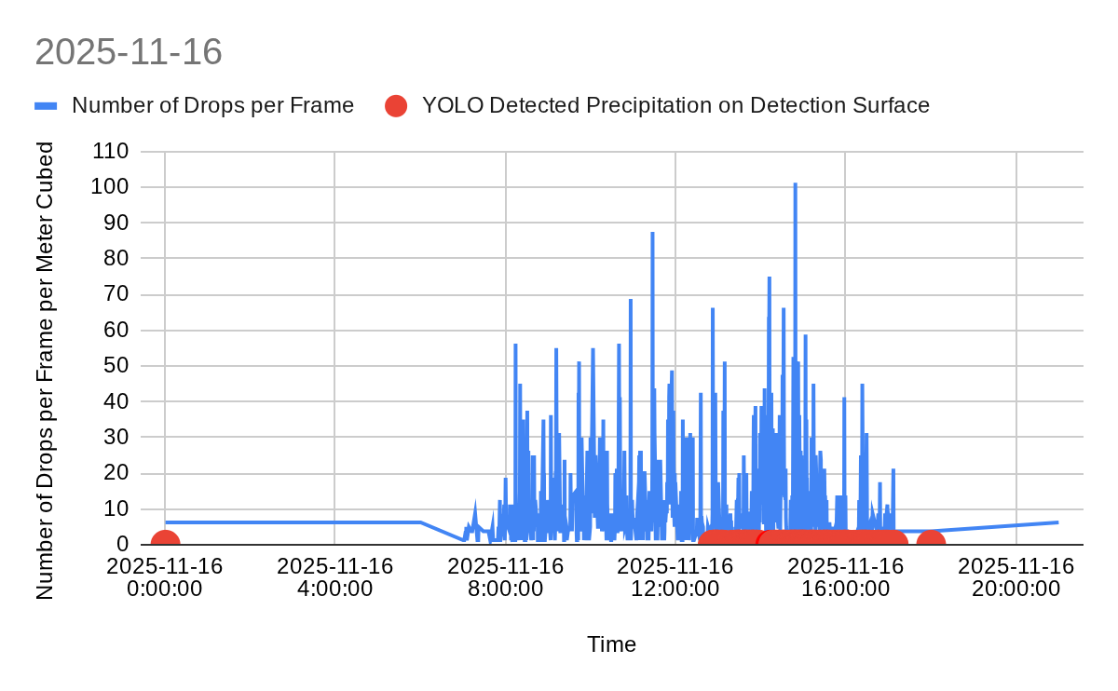

Slide 18
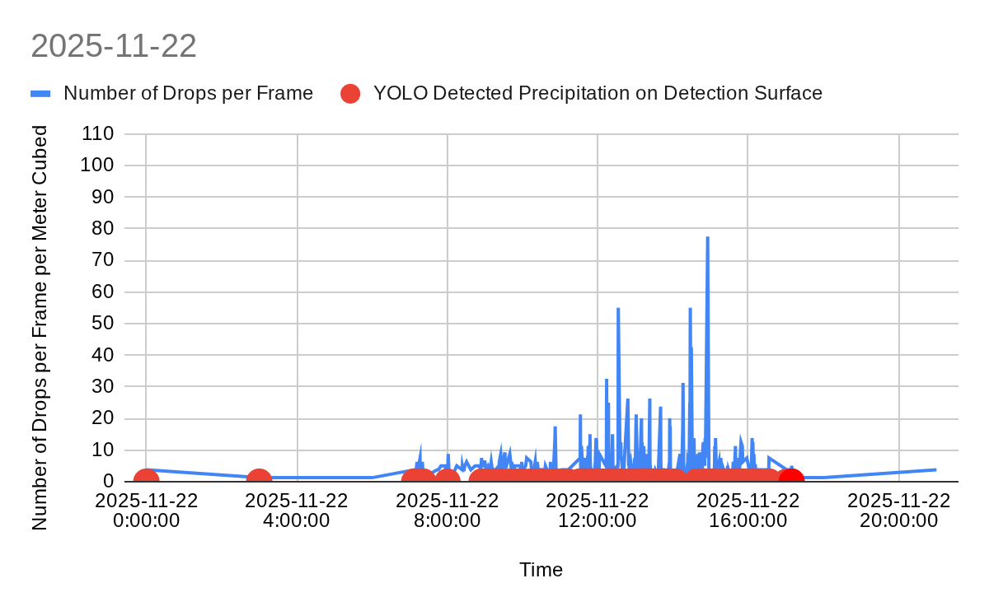

Slide 19
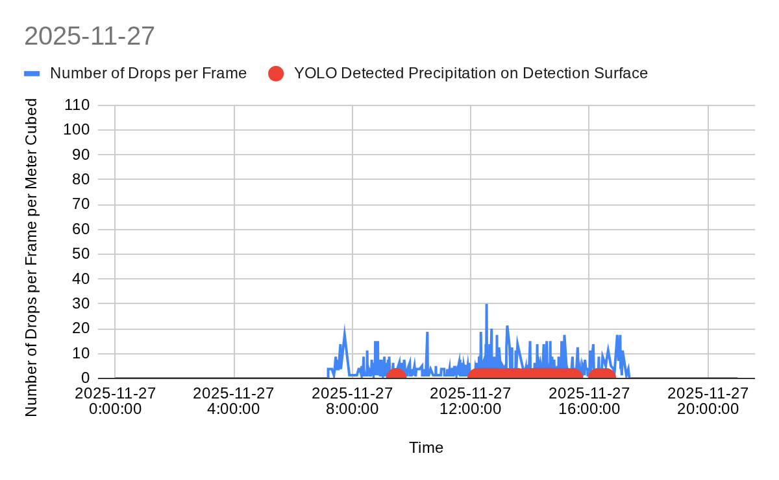

Slide 20
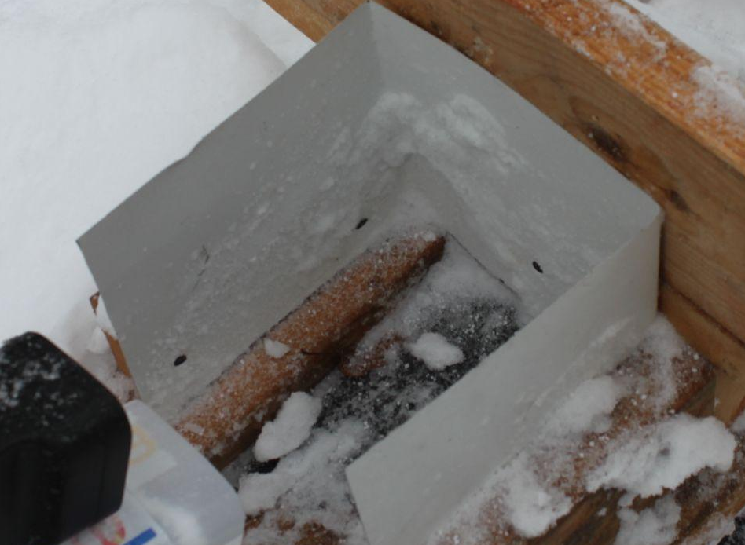
Conclusion
In conclusion, I was able to complete my objective. I was able to obtain output from my program that was reasonable. The program was able to detect when precipitation was on the flat platform and the density of the precipitation. The smallness of the raindrop detecting area may have affected the accuracy of the data.
20cm

Slide 21
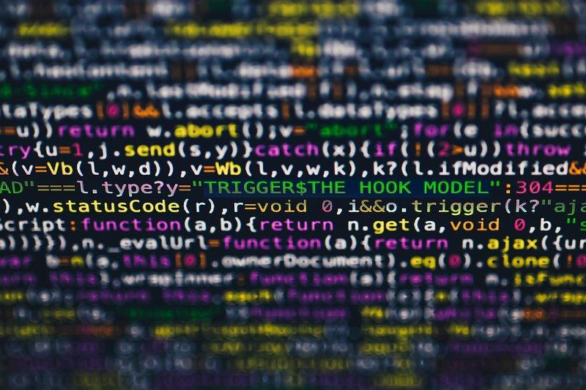
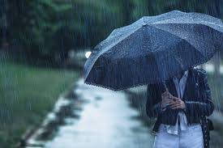
Importance
This is important because people can know the density of the falling raindrops, or how hard it is raining outside.
This could be a good start on a more complicated computer vision program, as I now know how to use motion detection and YOLO.

Slide 22
Furthering my Project
I would enlarge the raindrop detecting area for more accurate results.
I would train my YOLO model to detect hail, so that it could warn people when it was hailing.
I would make a website that people could visit that would show the current weather and the weather history.

Slide 23

Thank you
My Science Teacher
My Dad
My Teachers
My Siblings
My Classmates
You!!

Slide 24
Bibliography
“Camera, N. Meanings, Etymology and More | Oxford English Dictionary.” Oed.com, 2025, https://doi.org/10.1093//OED//6154609095. Accessed 19 Sept. 2025.
GeeksforGeeks. “Detect an Object with OpenCVPython.” GeeksforGeeks, 23 Jan. 2020, www.geeksforgeeks.org/python/detect-an-object-with-opencv-python/.
---. “What Is Object Detection in Computer Vision?” GeeksforGeeks, 10 May 2024, www.geeksforgeeks.org/computer-vision/what-is-object-detection-in-computer-vision/.
Holdsworth, Jim, and Mark Scapicchio. “What Is Deep Learning?” IBM, 17 June 2024, www.ibm.com/think/topics/deep-learning.
Khanam, Rahima, and Muhammad Hussain. “YOLOv11: An Overview of the Key Architectural Enhancements.” Arxiv.org, 2015, arxiv.org/html/2410.17725v1.

Slide 25
Bibliography
Kundu, Rohit. “YOLO: Real-Time Object Detection Explained.” Www.v7labs.com, 17 Jan. 2023, www.v7labs.com/blog/yolo-object-detection.
Ltd, Raspberry Pi. “Raspberry Pi.” Raspberry Pi, 2024, www.raspberrypi.com/.
May, Kelley. “What Is Artificial Intelligence?” NASA, 13 May 2024, www.nasa.gov/what-is-artificial-intelligence/.
Microsoft. “Artificial Intelligence vs. Machine Learning | Microsoft Azure.” Azure.microsoft.com, azure.microsoft.com/en-us/resources/cloud-computing-dictionary/artificial-intelligence-vs-machine-learning.
OpenCV. “About OpenCV.” OpenCV, 2018, opencv.org/about/.
Pi, Multiple cameras with the Raspberry, and OpenCV-PyImageSearch says. “Home Surveillance and Motion Detection with the Raspberry Pi, Python, OpenCV, and Dropbox.” PyImageSearch, 1 June 2015, pyimagesearch.com/2015/06/01/home-surveillance-and-motion-detection-with-the-raspberry-pi-python-and-opencv/.
PYTHON. “Python.” Python.org, Python.org, 2025, www.python.org/.

Slide 26
Bibliography
“Raindrop | Meteorology | Britannica.” Encyclopedia Britannica, 2025, www.britannica.com/science/raindrop. Accessed 3 Dec. 2025.
Staff, Coursera. “Computer Vision vs. Machine Learning: What’s the Difference?” Coursera, 2025, www.coursera.org/articles/computer-vision-vs-machine-learning. Accessed 20 Sept. 2025.
Tam, Adrian. “Training a Haar Cascade Object Detector in OpenCV - MachineLearningMastery.com.” MachineLearningMastery.com, 9 Dec. 2023, machinelearningmastery.com/training-a-haar-cascade-object-detector-in-opencv/. Accessed 22 Sept. 2025.
“The Mechanism of a Digital Camera / Digital Camera Basic Knowledge / PHOTO STYLE / Digital Cameras | Ricoh Global.” Www.ricoh-Imaging.co.jp, www.ricoh-imaging.co.jp/english/r_dc/photostyle/knowledge/preparation/digitalcamera.html.

